Slide 1
NLP
Presenter: 109368093 梁有騰

Slide 2
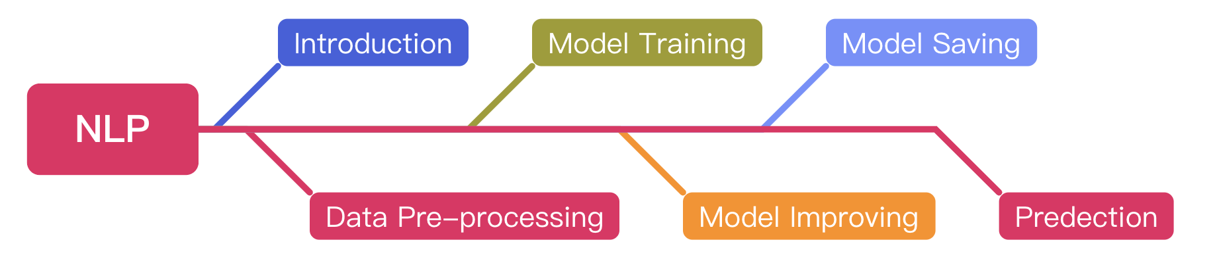
Outline

Slide 3
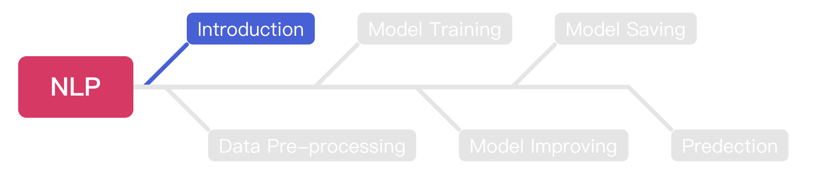
Outline

Slide 4
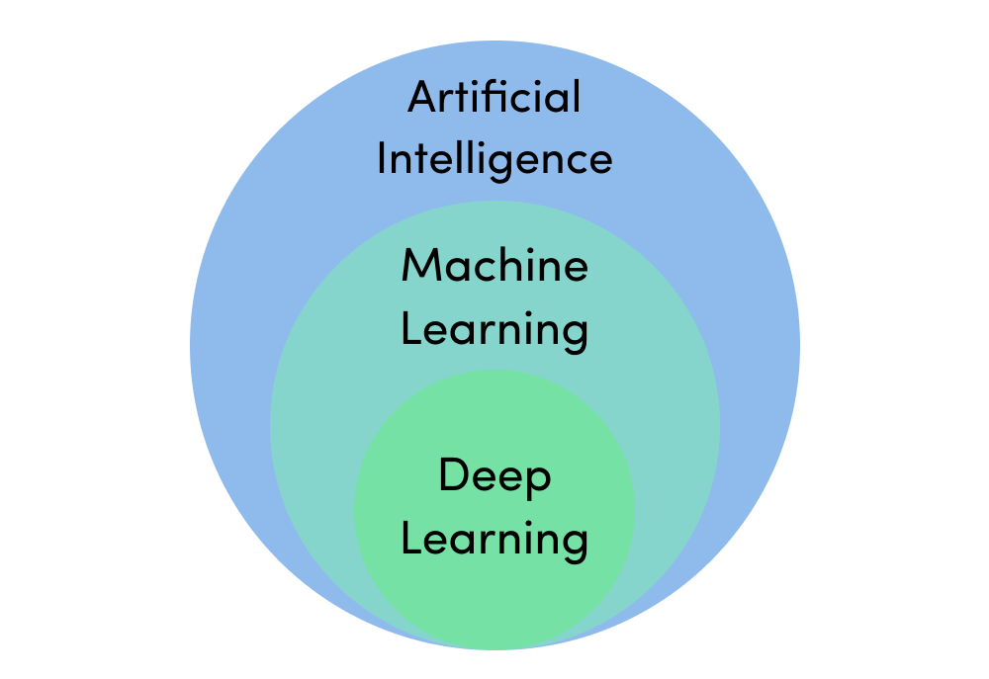
Machine Learning & Deep Learning
https://assets.website-files.com/5fb24a974499e90dae242d98/5fb24a974499e96f7b2431db_AI%20venn%20diagram.png

Slide 5

Deep Learning Model
https://towardsdatascience.com/converting-a-simple-deep-learning-model-from-pytorch-to-tensorflow-b6b353351f5d

Slide 6
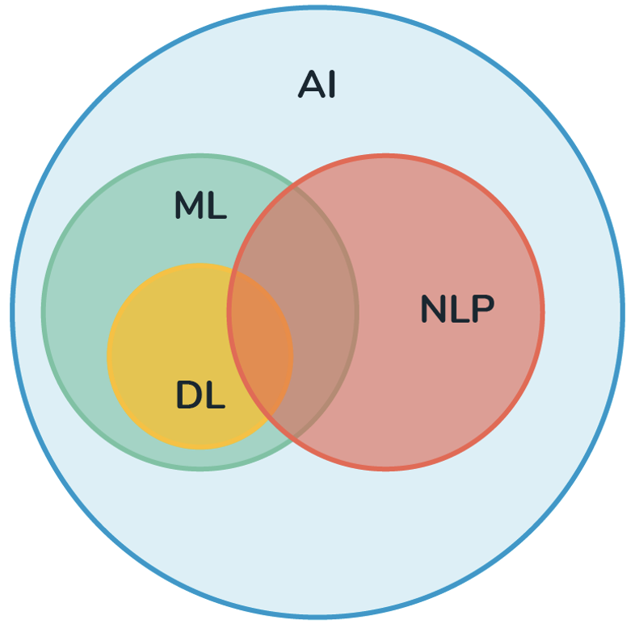
NLP
Natural Language Processing.
NLP is a subfield of computer science.
The main idea of NLP is to make your computer understand the human language ex. English or Mandarin.
https://medium.com/@derekliao_62575/%E8%87%AA%E7%84%B6%E8%AA%9E%E8%A8%80%E8%99%95%E7%90%86-nlp-%E5%88%B0%E5%BA%95%E6%98%AF%E4%BB%80%E9%BA%BC-e29ab6356f6d

Slide 7
Supervised Learning
Supervised learning is one of method machine learning
The researchers will provide a set of question-answer pairs.
The model will try to figure out the connection between each question and corresponding answer.
After training, this model can answer the questions that never seen before.

Slide 8
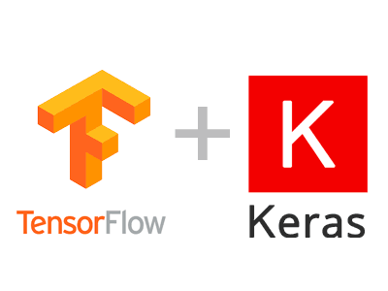
TensorFlow vs. Keras
TensorFlow is a machine learning model build by C++, it can help user to train a machine learning model.
Keras is a package that can help users to invoke TensorFlow easier.
The functions Keras provided can help user to create and train a NN model easier.
https://dsalearning.github.io/tf.keras/2-2-tf-keras-python-dl-env/

Slide 9
TFDS
TFDS is a python model that can help use to get datasets.
Install TFDS with pip.
pip install tensorflow-datasets.
Using load() to load a data set
tfds.load(‘fashion_mnist’)

Slide 10
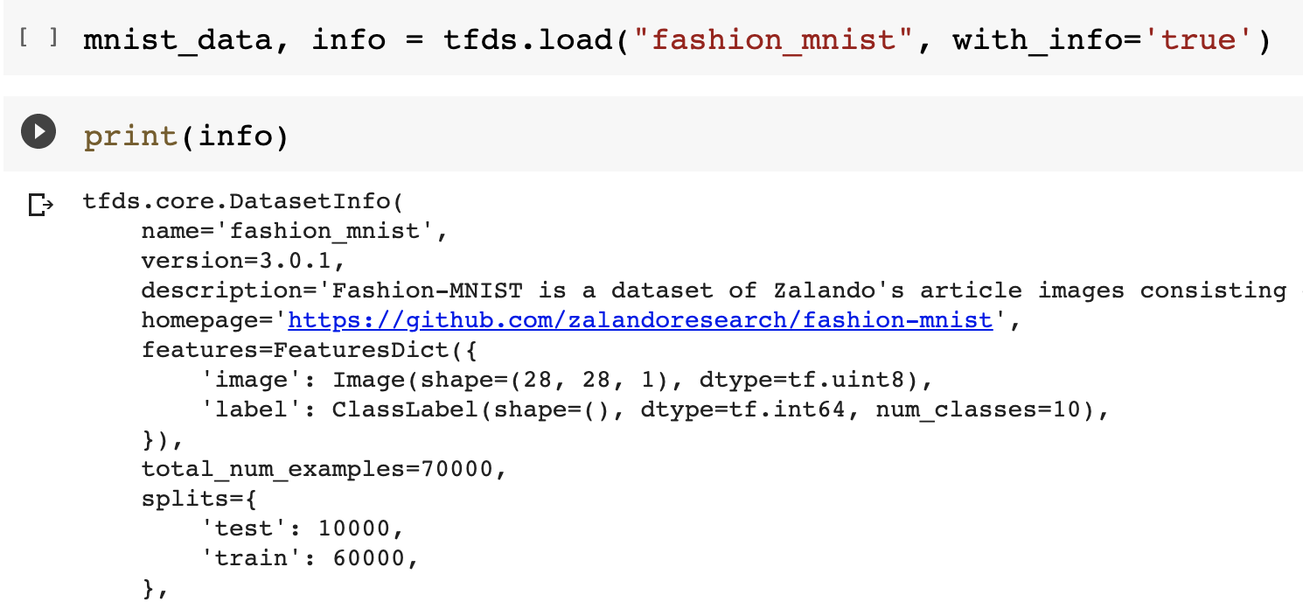
TFDS (Cont’d)

Slide 11
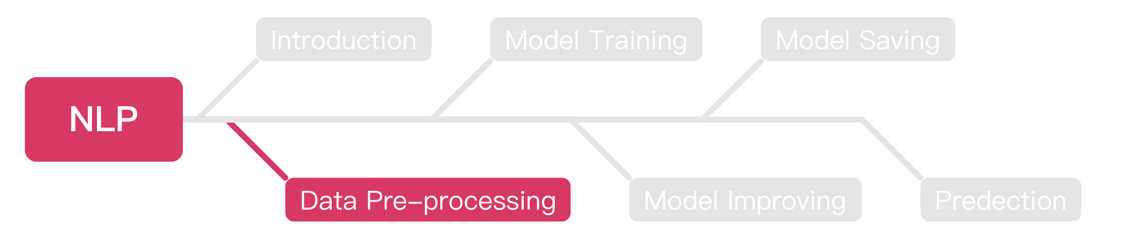
Outline

Slide 12

Sarcasm Detection
We are going to build a sarcasm detection model.
This model can help us to classify the sentence sarcasm or not.
We will complete this experiment with Keras.
https://www.wyo.in/pub/media/mf_webp/png/media/catalog/tmp/category/Sarcasm.webp

Slide 13
Embedding
At the beginning, each word has a sarcasm score 0.
The score will +1 if that sentence is labeled as sarcasm, -1 if not.
After thousands of rounds, we can get a final score of each word.
Calculate the total score of each sentence.
If the score > 0, we say this sentence is sarcasm.

Slide 14
Embedding (Cont’d)
There are two sentences “You love dog” and “How nice you are”.
We set “You love dog” as not sarcasm, “How nice you are” as sarcasm.
We know all words have 0 point at the beginning.
So, we can get the score of each word like below:
[you: 0, love: -1, dog: -1, how: 1, nice: 1, are: 1 ]
The score of ”you” will be like -1 + 1 = 0.
We can get the score of “How a nice person” as 1 + 0 + 1 + 0 = 2.
So we can say “How a nice person” is a sarcasm sentence.

Slide 15
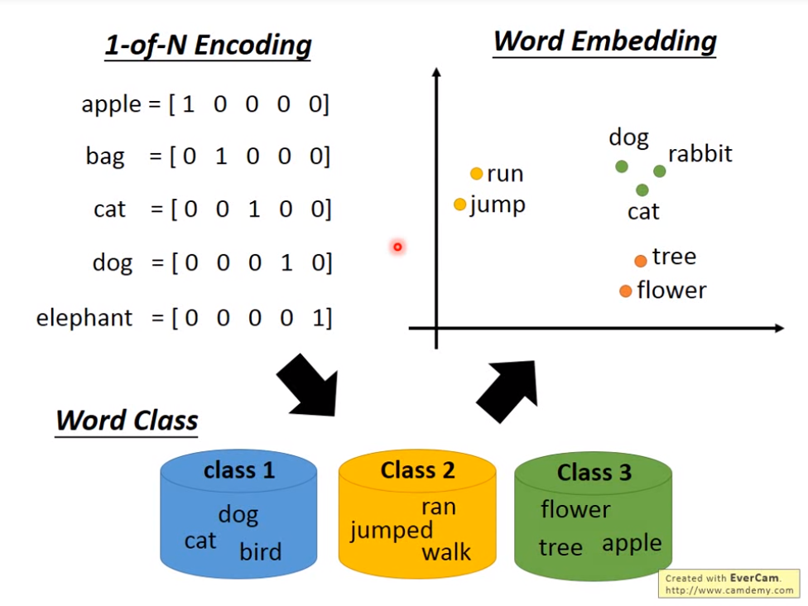
Embedding (Cont’d)
After embedding, we can get the vector of each word.
https://hackmd.io/@shaoeChen/B1CoXxvmm/https%3A%2F%2Fhackmd.io%2Fs%2Fr1iKfZu2Q

Slide 16
Tokenization
We can replace the words with numbers in a sentence.
“I love dog” = [0, 1, 2, 3]
“I love cat” = [0, 1, 2, 4]
“I love a cat” = [0, 1, 2, 5, 4]

Slide 17
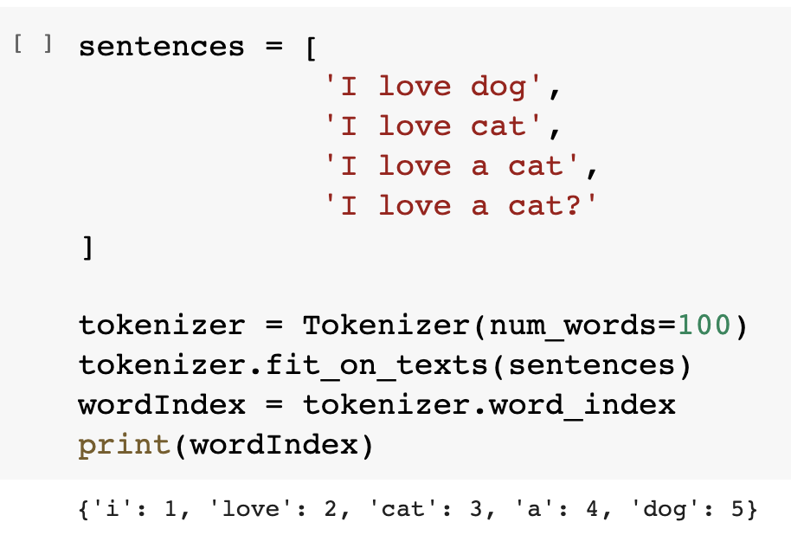
Tokenization (Cont’d)
We can use python package to do the tokenization easily.

Slide 18
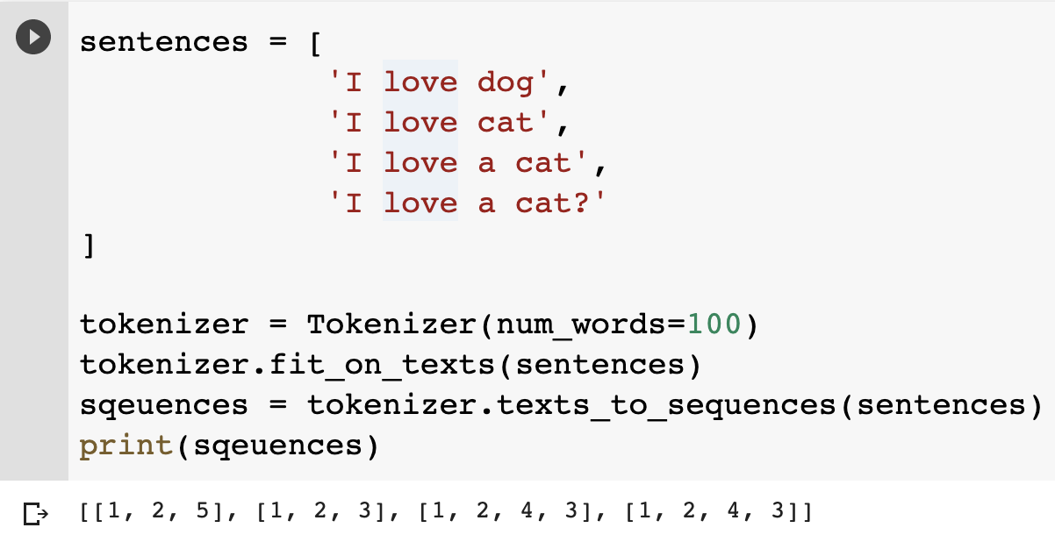
Texts to Sequences
We should combine the IDs with the sentences.

Slide 19
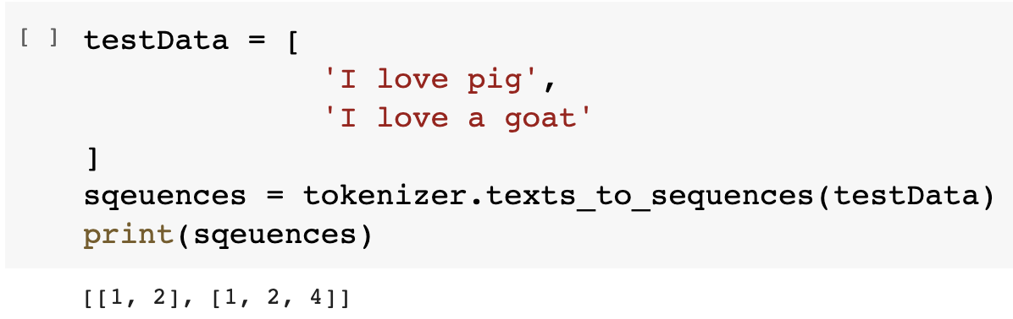
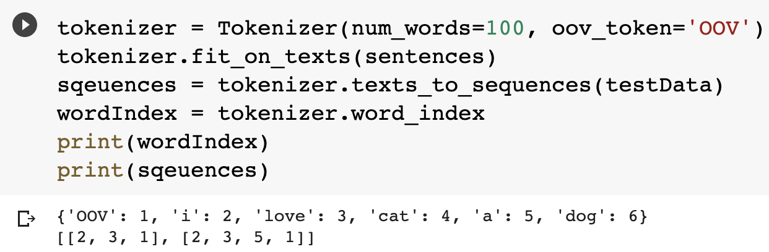
Out of Vocabulary (OOV)
OOV means your algorithm can’t understand the word, it means this word doesn’t exist in the vocabulary.

Slide 20
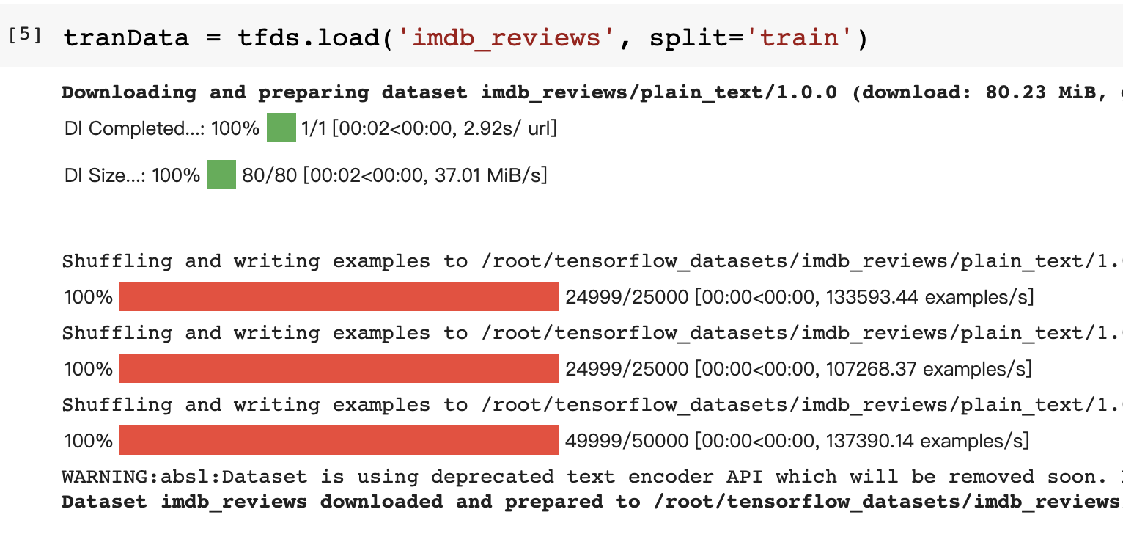
Get Texts from TensorFlow
We can get the texts from TensorFlow.

Slide 21
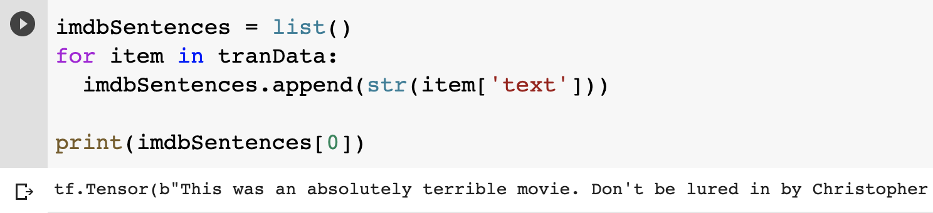
Get Texts from TensorFlow (Cont’d)
After loaded, we can append each sentence into a list.
We can try to print the first data.

Slide 22
Sarcasm Detection
From now on, we will start to build a model for sarcasm detection.
We will use the NLP analyzing skills we learned before to build a ML model.
The format of example dataset is *.json, but the format for practice data set will be *.csv, please try to load it into python and use it to train your own model.

Slide 23
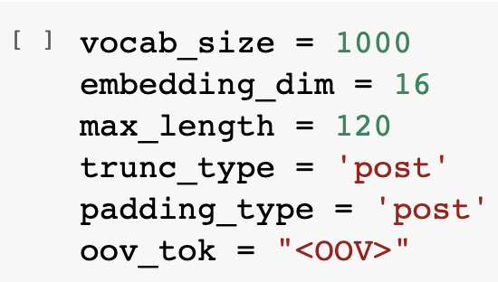
Parameters Declaration
These parameters will be use during our model defining part, you can try to set it to different value and observe the differences.

Slide 24
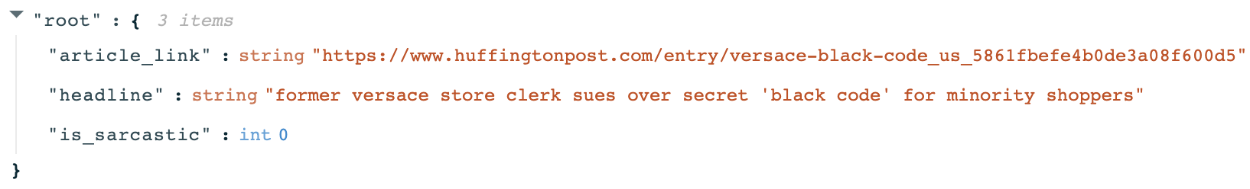
Sarcasm Dataset
The following is the format of the sarcasm dataset as .json file, you should load and categorize all data as well.

Slide 25
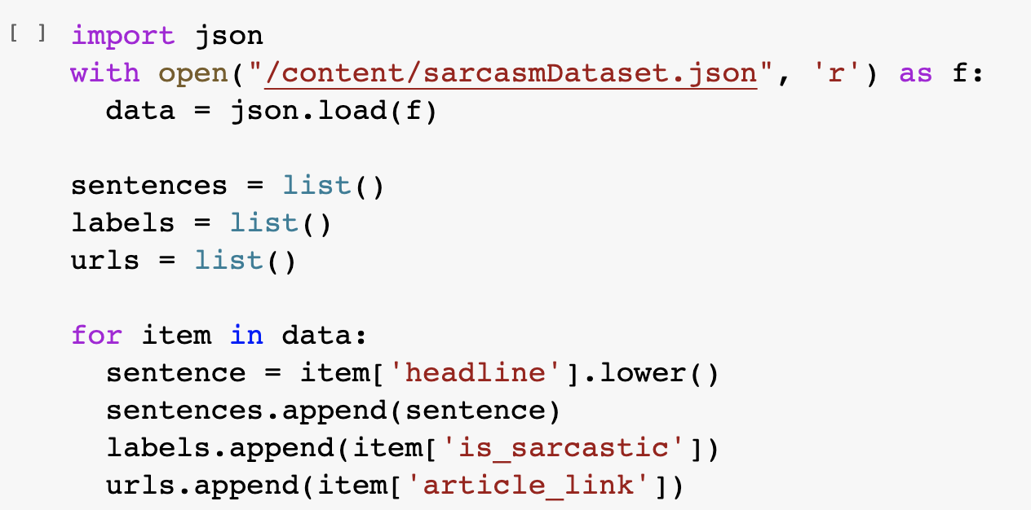
Load the Data from Json File
Basically, dataset will given by *.json or *.csv formats.
The following is the process of loading dataset form .json file.

Slide 26
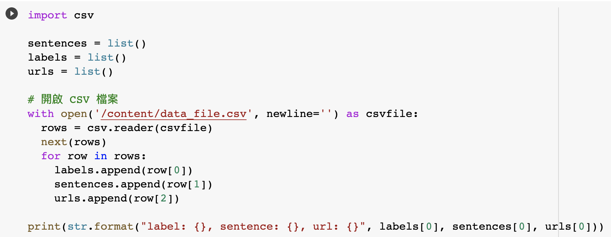
Load Data from CSV File
You can load the data from CSV file with these steps:

Slide 27
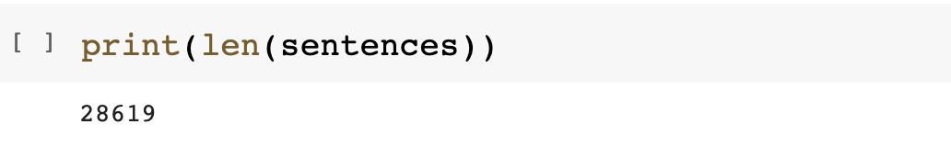
Amounts of Data
We can use len() to observer the size of data that intended to train.
Obviously, len() says we have 28619 data loaded from .json dataset.

Slide 28
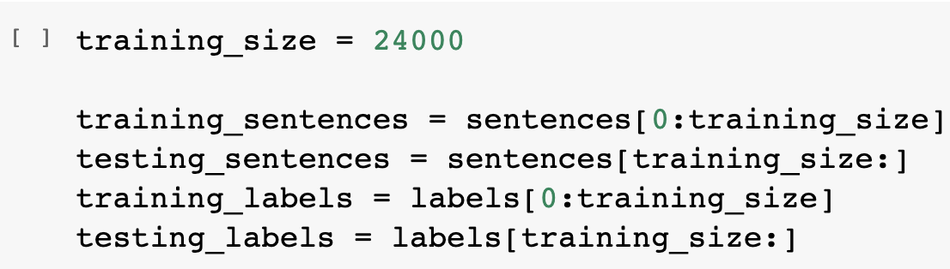
Split Dataset into Training and Testing
Since the dataset didn’t provide us the testing data, we should split it from origin dataset ourself.
We choose 24000 data for training and 4619 for testing.

Slide 29
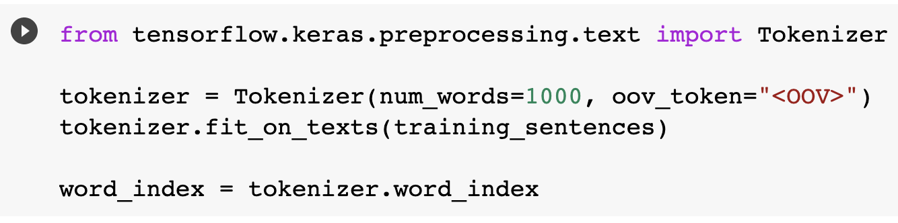
Tokenizing the Data
We should transfer our data from NLP to word index before training.
We can use fit_on_texts() to transfer it easily.

Slide 30
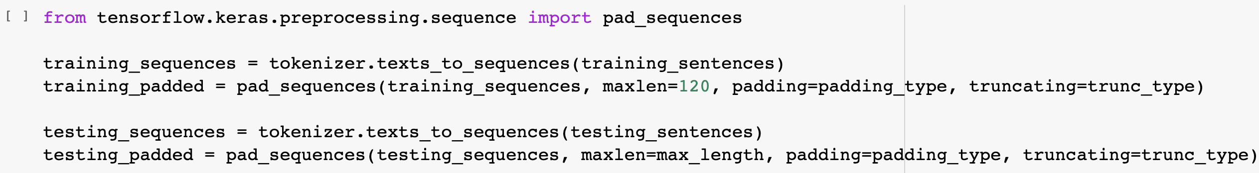
Pad Sequences
After tokenizing, we should get the word index back to sequences.
Keras provides a simple method pad_sqeuences() to do that.

Slide 31
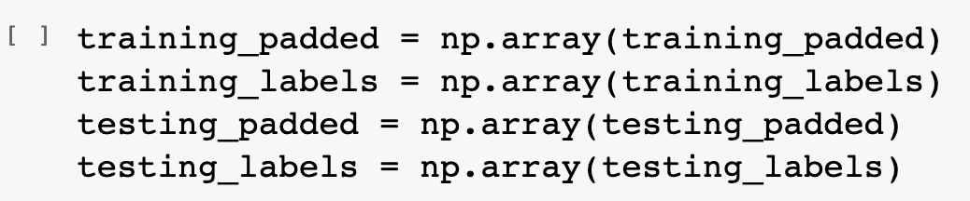
Turn the Data into Numpy Array
There’s one thing we should do before training, transfer all data into Numpy array.
Since all parameters in Keras are Numpy array, we should transfer our data as well
Simple, just call np.array() to transfer your data.

Slide 32
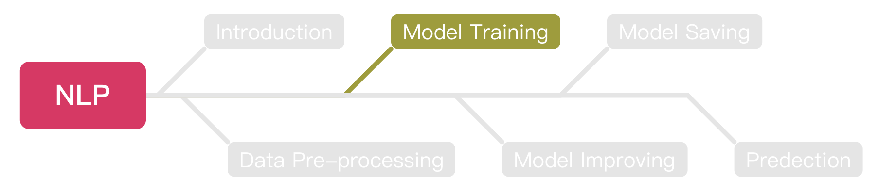
Outline

Slide 33
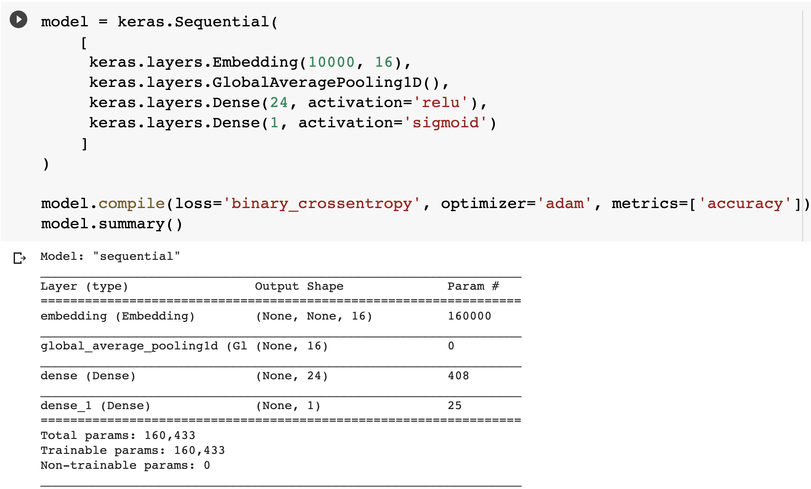
Building the Model

Slide 34
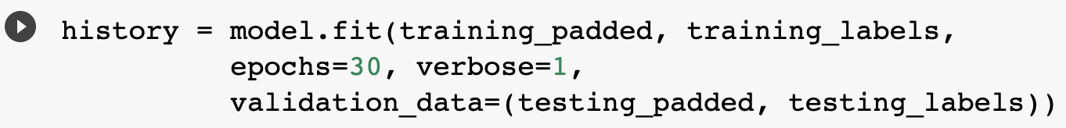
Training the Model

Slide 35
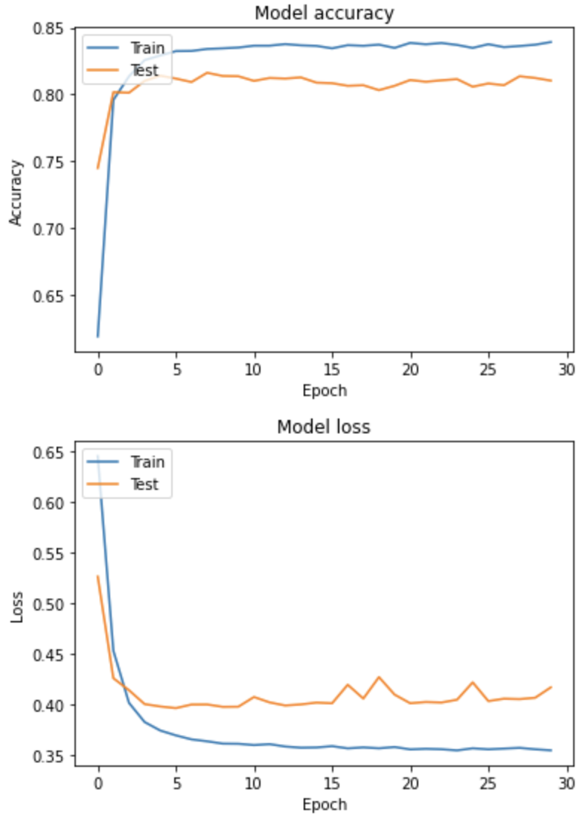
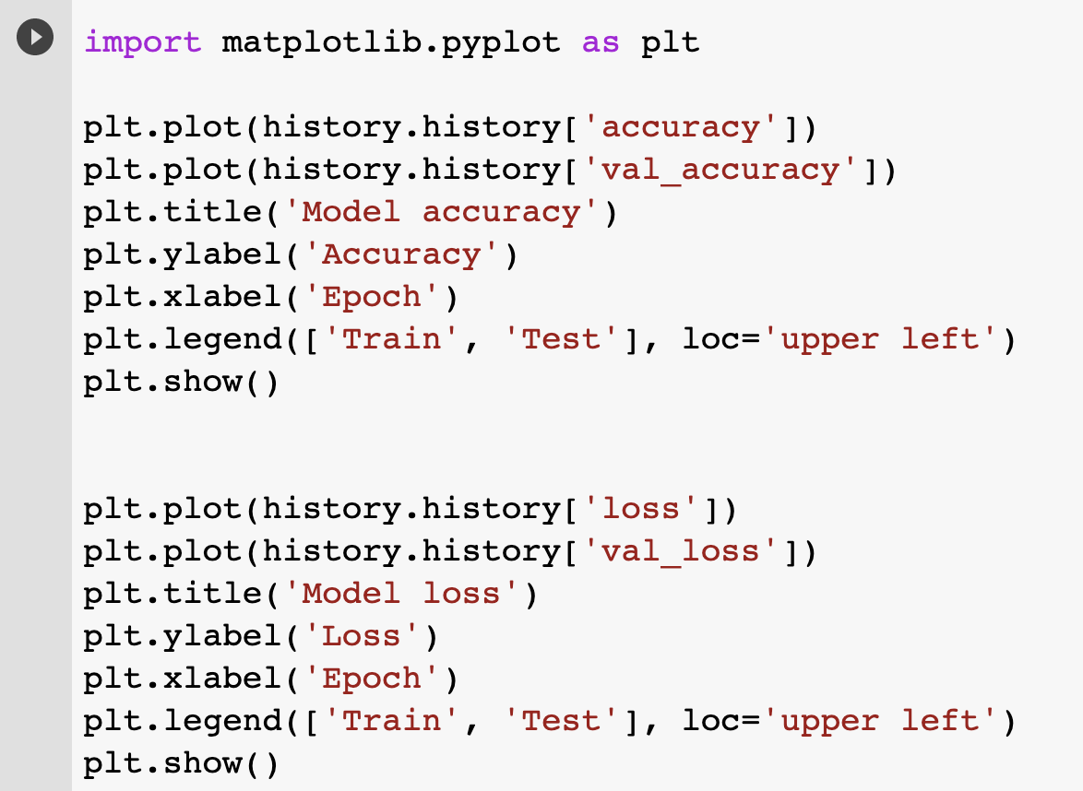
Plotting the Results

Slide 36
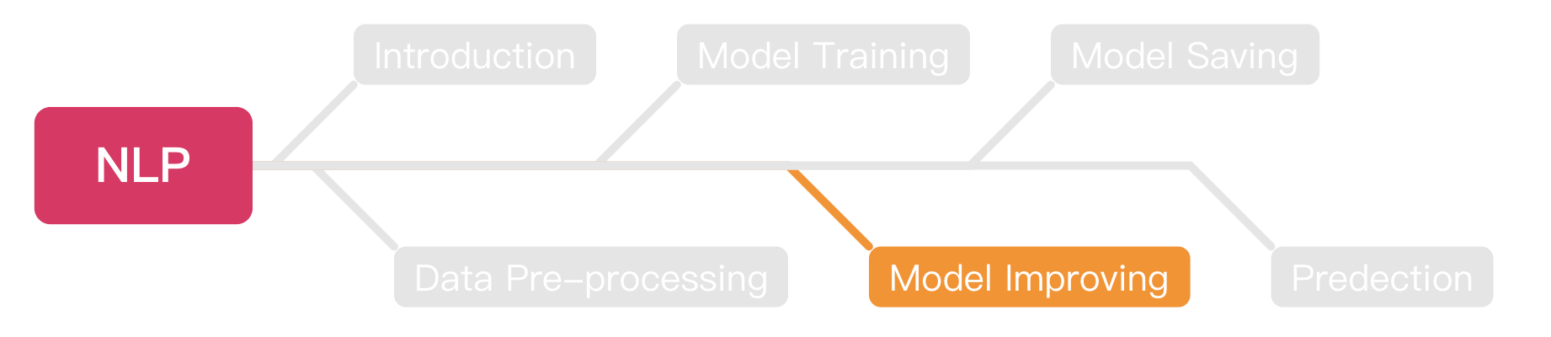
Outline

Slide 37
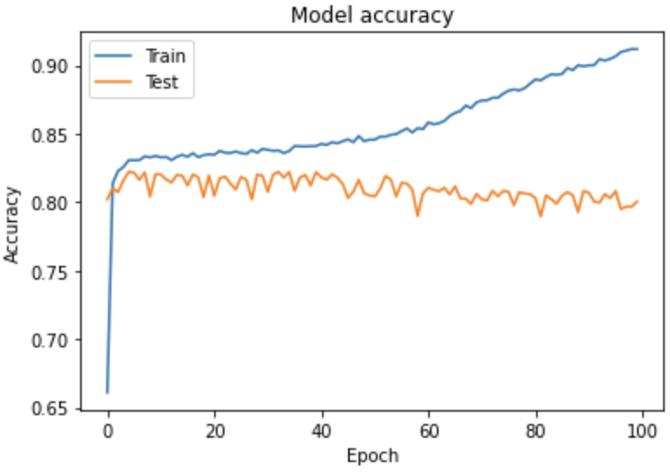
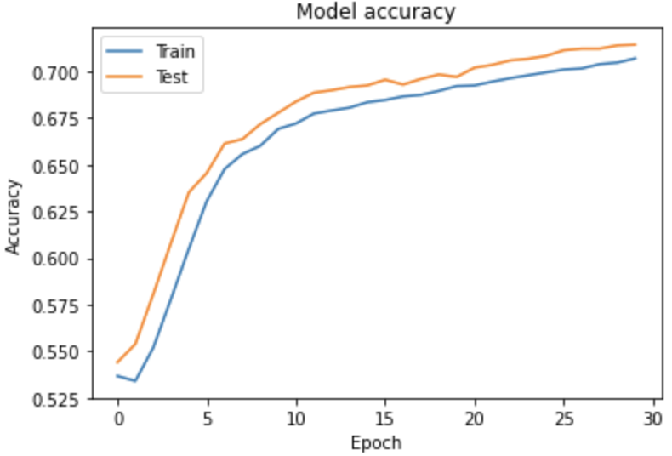
Before Model Improving
We should know these two different status before model improving:
Overfitting
Underfitting

Slide 38
Overfitting
Overfitting is a problem that will happened during training your model.
You can simply understanding it like:
When you are studying math.
You just memorize all the answers on your textbook.
You will fall when the problem of exam has a little bit different.
Same, if your model just memorize all the answers, how it will be if the text data has all bit change ?

Slide 39
Overfitting (Cont’d)
So, how do we fix the overfitting problem ?
The most simple way is to use the pre-trained models.
Normally, pre-trained models already have the best weights, we just need to invoke it and add it into our model.

Slide 40
Underfitting
Underfitting means your model can do better.
You should increase the epochs or the layer amounts to exploit the model to avoid underfitting.

Slide 41
Improving our model
After we know how to train our model, next step is to improve it.
We will try these ways to improve our model:
Increase the training epochs.
Add more hidden layers.
Use another NN for training.
Increase the amounts of data.
Use pre-trained model (Transfer learning).
Improve the optimizer.

Slide 42
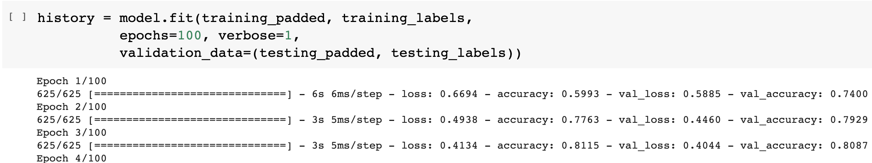
Improving the Epochs
The simplest way to try is improve the training epochs.
For example, increase from 30 to 100.

Slide 43
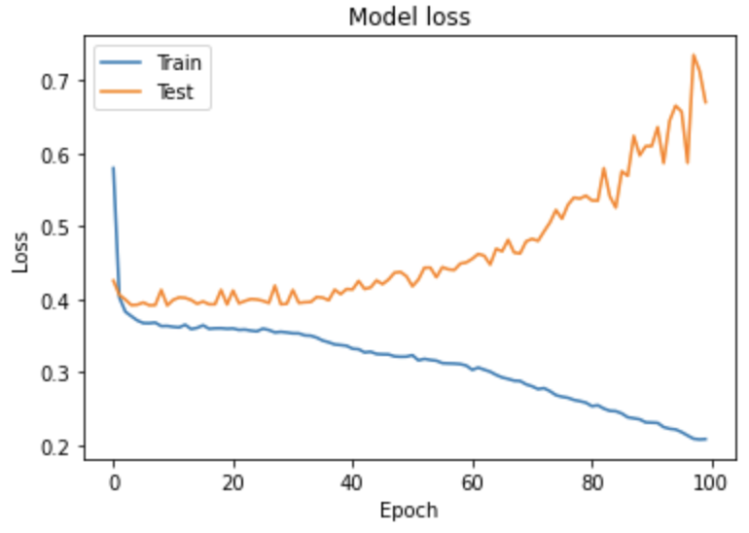
Improving the Epochs (Cont’d)
Let’s see the results.

Slide 44

Next Steps
https://medium.com/initialized-capital/we-need-to-go-deeper-a-practical-guide-to-tensorflow-and-inception-50e66281804f

Slide 45
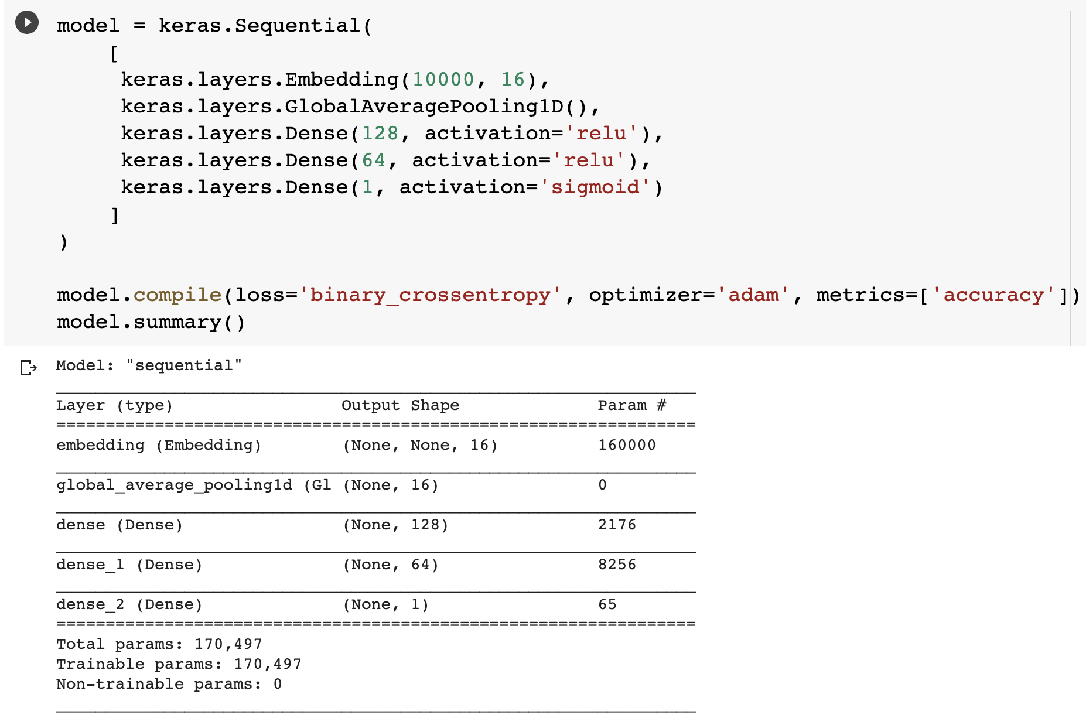
Training with More Hidden Layers

Slide 46
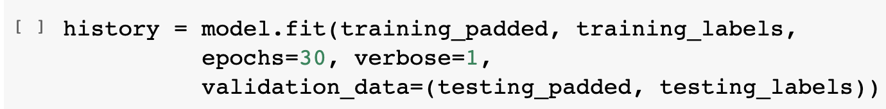
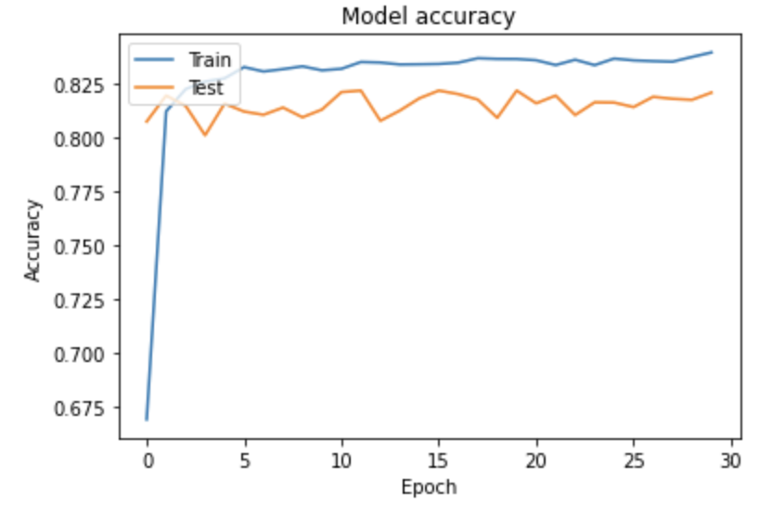
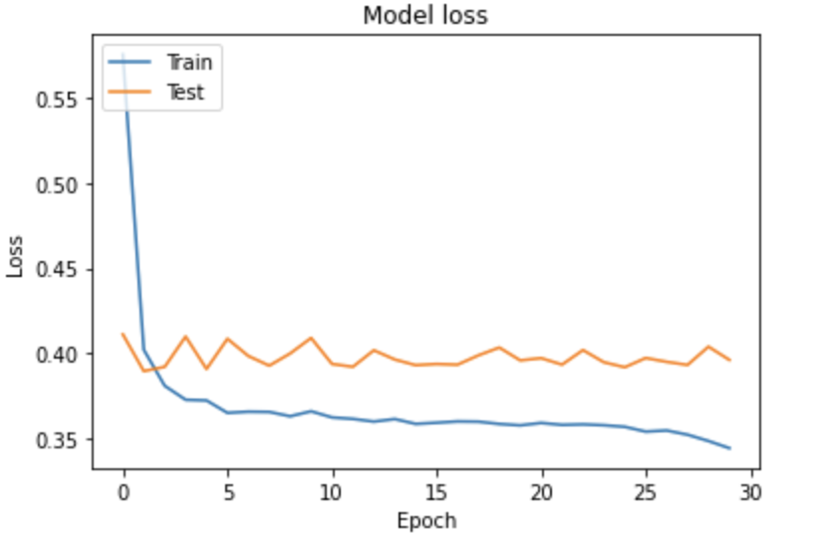
Training with More Hidden Layers (Cont’d)

Slide 47
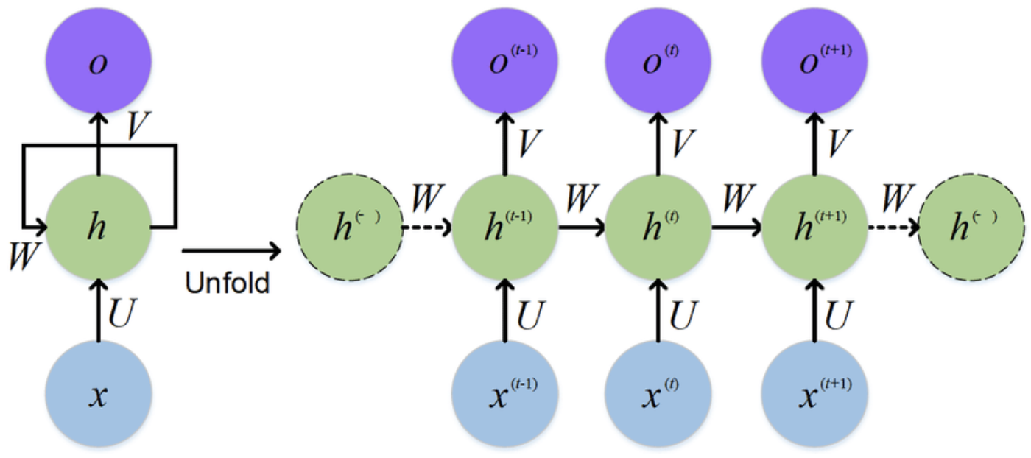
RNN
RNN means recursively neural network.
RNN is one of the popular NN models, the characteristic is RNN will re-train the model with new data.
https://www.researchgate.net/figure/The-standard-RNN-and-unfolded-RNN_fig1_318332317

Slide 48
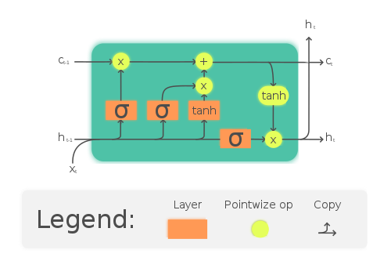
Long Short Term Memory
LSTM is the most popular implementation of RNN.
The simple way to understand LSTM is:
It will re-train the data with new data.
It will dropout the data that is not important.
It has a gate to determine if the data can be output to next layer.

Slide 49
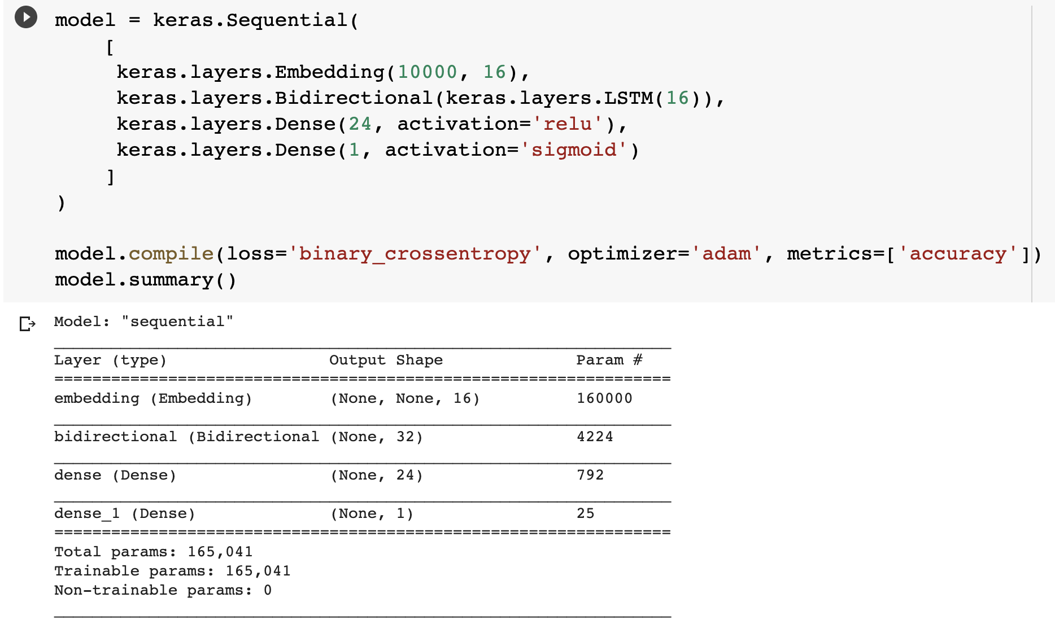
Training Model with LSTM
We can use the build-in LSTM layer of Keras to train our model.

Slide 50
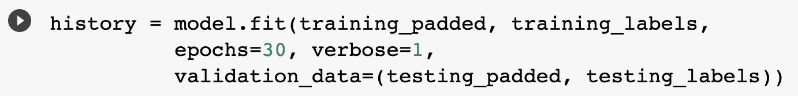
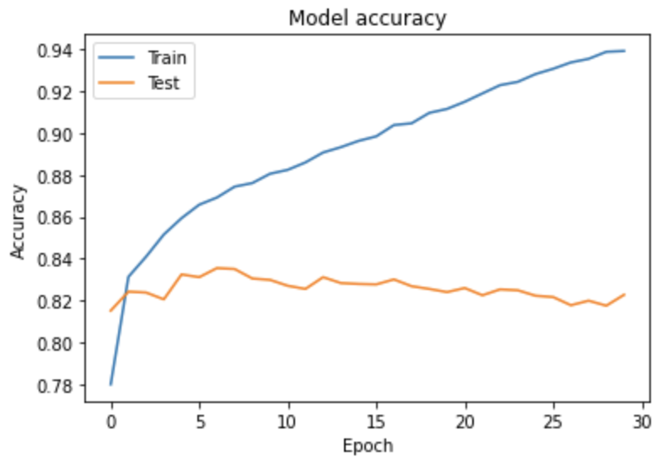
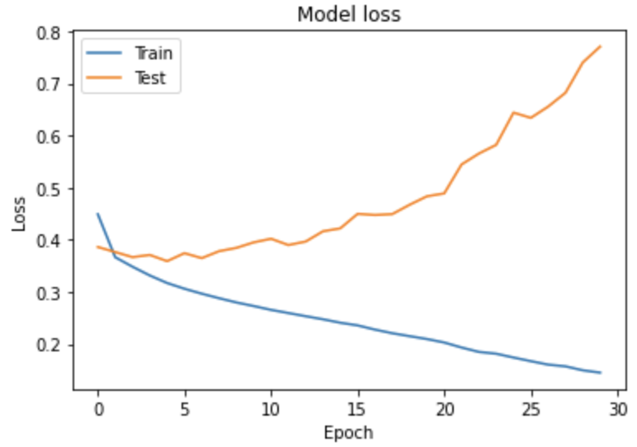
Training Model with LSTM
Let’s see the results.

Slide 51
Pre-trained Model
The pre-trained model we will use is tf2-preview/gnews-swivel-20dim.
It is the pre-trained model provided by Google.
This pre-trained model has 130GB corpus of English Google News.
You can see the detailed information in this website.
https://tfhub.dev/google/tf2-preview/gnews-swivel-20dim/1

Slide 52
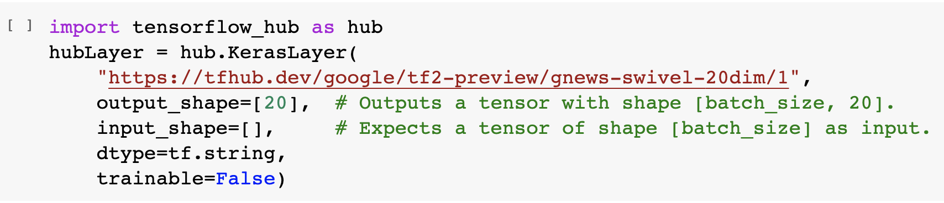
Pre-trained Model (Cont’d)
Now we are trying to invoke the pre-trained model.
Luckily, this pre-trained model is included in TensorFlow Hub.

Slide 53
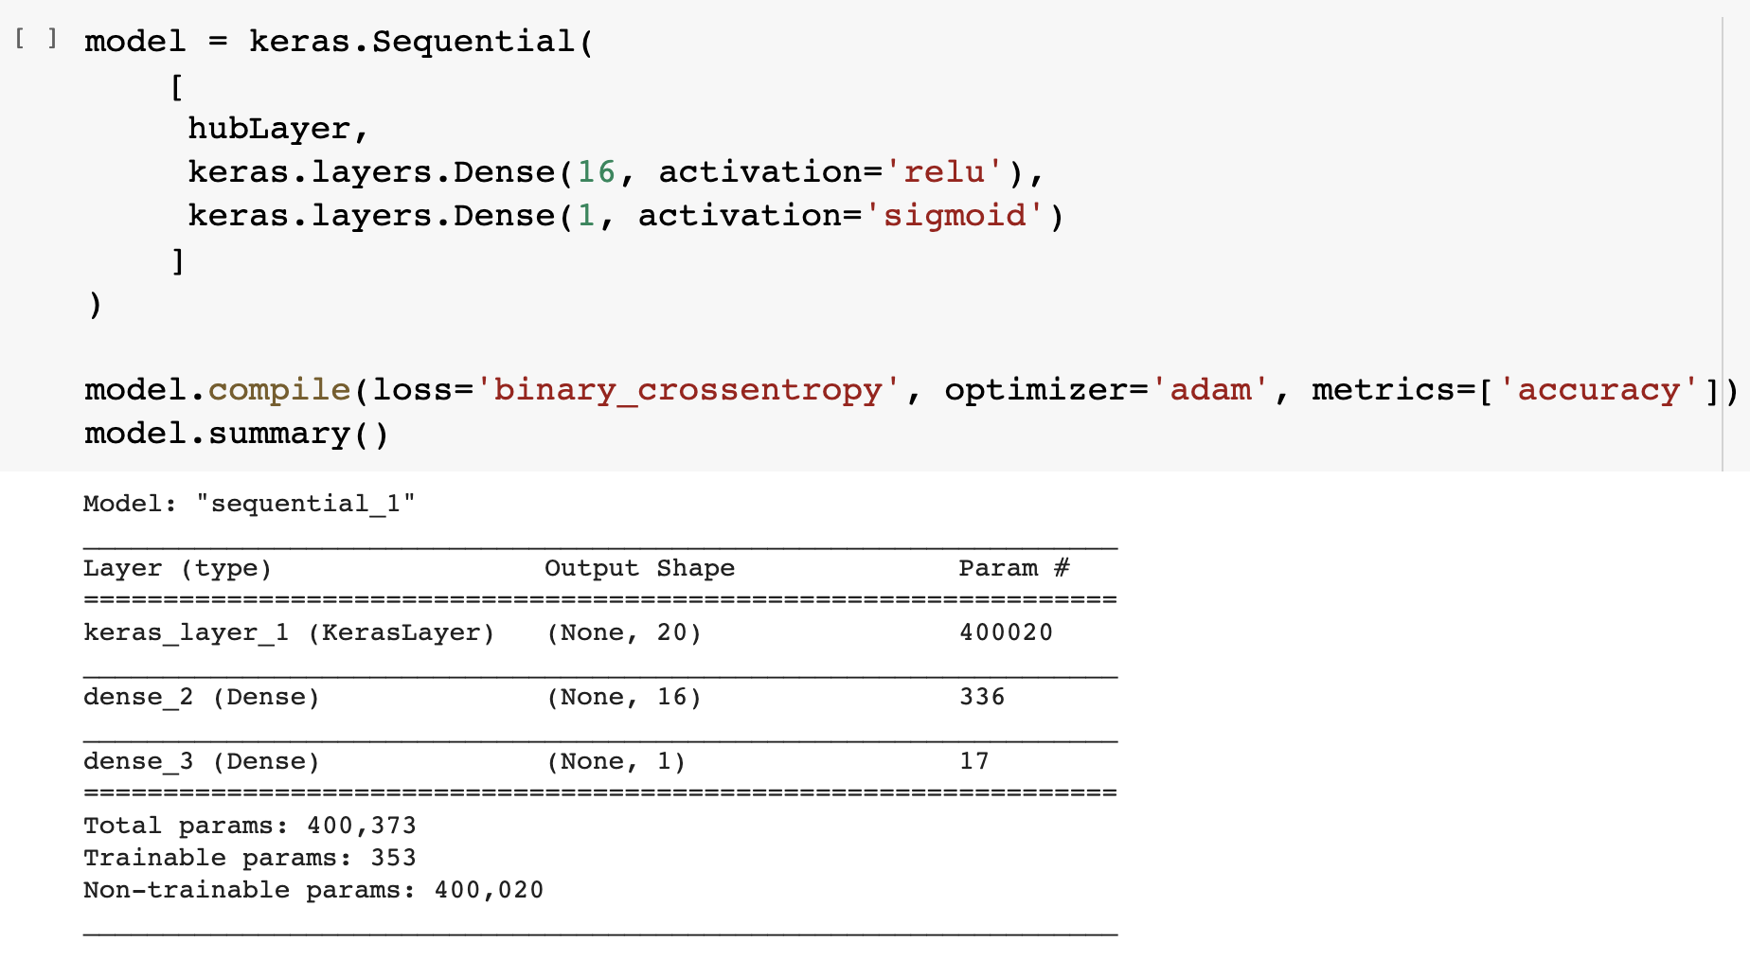
Training the Data with Pre-trained Model

Slide 54
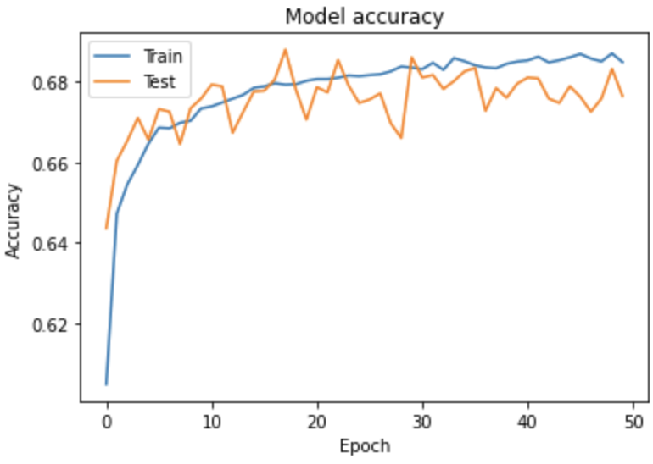
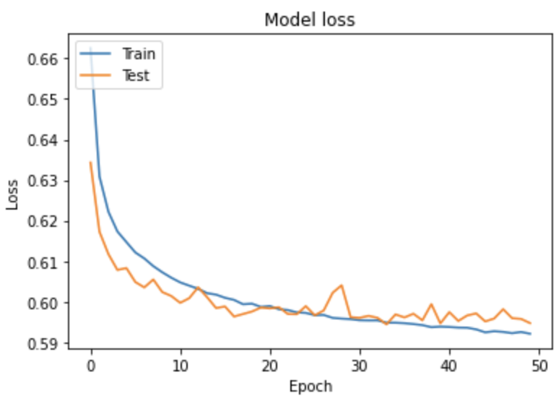
Training Results

Slide 55
Training Results (Cont’d)
We can see that, the overfitting problem is fixed.
But seems the accuracy is not so good.
The accuracy is under 70%.

Slide 56
Training with More data
Since the data we have is not enough.
We should standing on the shoulders of giants.
Let’s use GloVe to train our model.
GloVe collects more than 2B tweets on Twitter.
The dataset more than 1.4 GB !

Slide 57
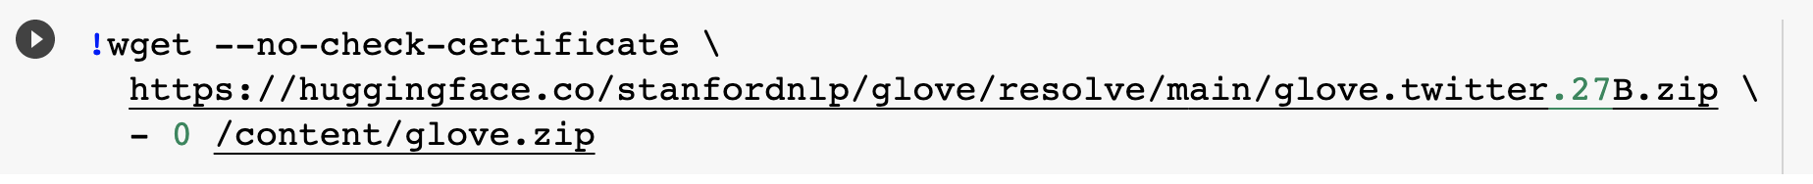
Downloading GloVe Dataset
We can download the dataset with a simple Linux command.
Or, you can download it via this link.
https://huggingface.co/stanfordnlp/glove/resolve/main/glove.twitter.27B.zip

Slide 58
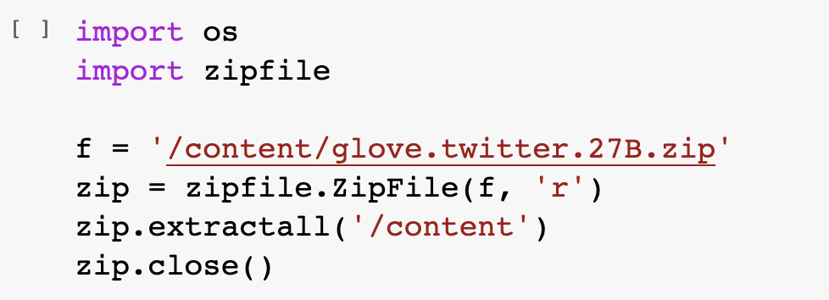
Unzipping the dataset
Python zipfile package can help you to zip or unzip files.
Always remember to close file stream after your works done.

Slide 59
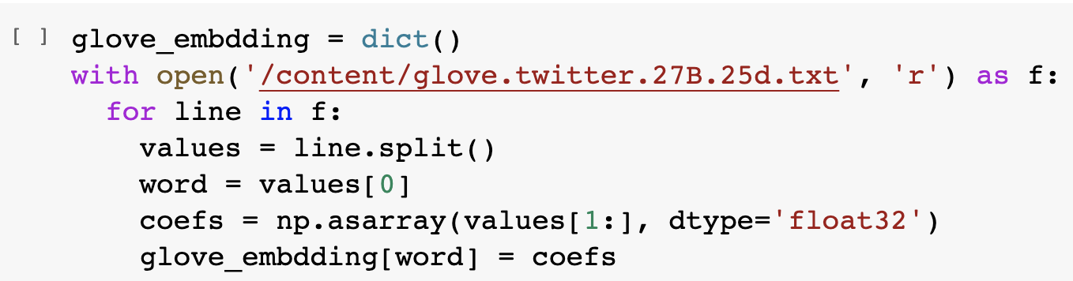
Loading the Data
Now, let’s try to load the data from the dataset.
We choose to use 27B.25d.text this file.
It means it has 27B of tokens and each tokens has 25 dimensions.

Slide 60

Try to Print the Coefficients
After we loaded the data, we can try to print the coefficients.

Slide 61

Filter the Data
Since this dataset is too large, it will take lots of time for training.
We just take what we need.

Slide 62

Preparing the Model

Slide 63

Training the Model
First, we juts train it with 30 epochs to see the results.

Slide 64


Results
Well, I don’t like the results.

Slide 65
Optimizer
Don’t worry, we still have the last skill.
Modify the optimizer.

Slide 66

Optimizer (Cont’d)

Slide 67

Results
Please enjoy the results for 30 epochs.

Slide 68


Results of 50 Epochs

Slide 69


Results of 70 Epochs

Slide 70
Results
Seems 50 epochs is the best solution.
Next step is to save our model.

Slide 71

Outline

Slide 72

Save the Model
You can save your trained model for next time prediction with these steps.

Slide 73

Outline

Slide 74

Loading Saved Model to Predict
You can load the local model with simple steps:
After loaded, this model can be used for prediction.

Slide 75

Before Prediction
We should do the same steps to the data we intended to predict as the training data.
Just do that quickly.

Slide 76
Before Prediction (Cont’d)
Keep doing the pre-processing of our data.

Slide 77

Prediction
You can do the prediction with:
Just one step, does it easy enough?

Slide 78
Training your own model
We prepare two datasets for you to train your own model, both are stored as .csv file.
Of course, you can do the exactly same this with us to build a workable model, but I pretty sure it will be fascinating if you build your own one with difference method.
Link to datasets: https://drive.google.com/drive/folders/1kwORuSfpuPlqKKLFc3rhT0nHusqA6EzF?usp=sharing

